Slide 1

CEIS150 Module 7
GUI

Slide 2
Rubric
Activity | Requirement(s) | Points
Stocks in GUI | Screen shot of working program | 15
History complete | Screen shot of working History Tab | 15
Report Complete | Screen shot of Report Complete | 10

Slide 3
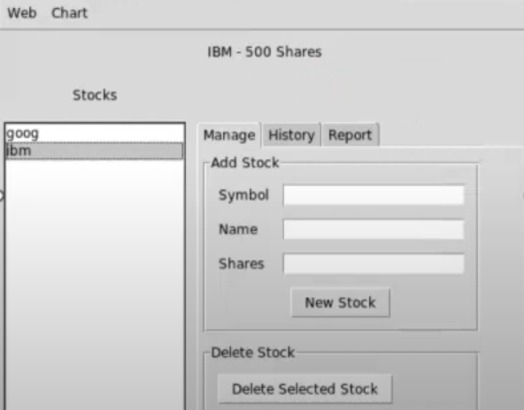

Stocks in GUI
Paste a screen shot of your GUI working

Slide 4
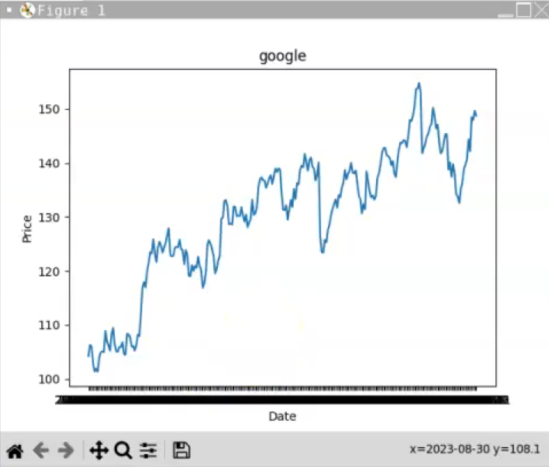
History Tab
Paste a screen shot of your History tab with import working.

Slide 5
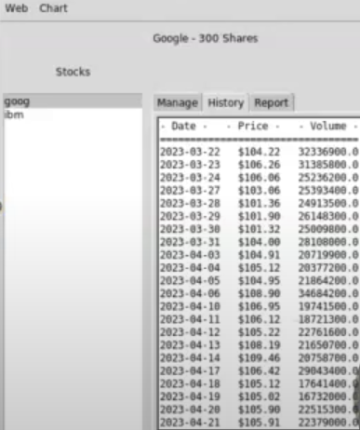
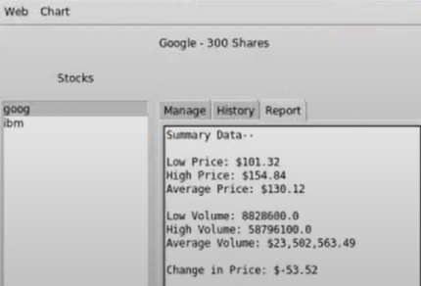
Report Complete
Paste a screen shot of your Report tab

